Slide 1
Summary Report of Working Group 2: Cadastre and Land Management
13 March, 2023 Singapore

Slide 2
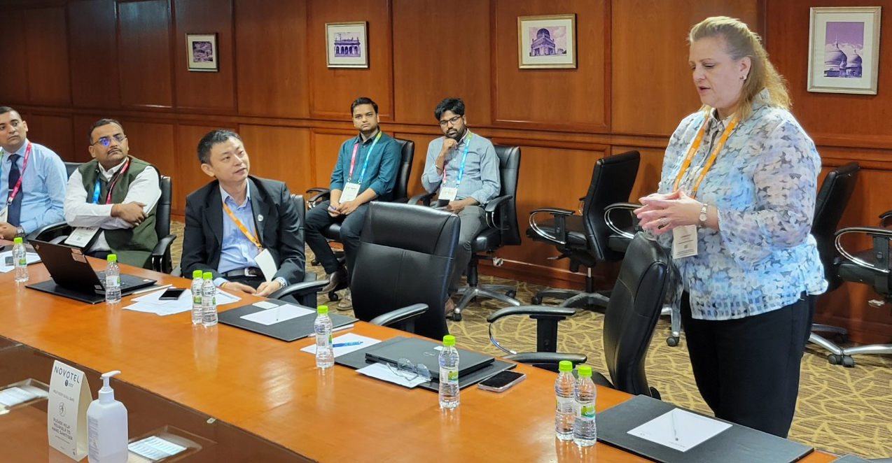
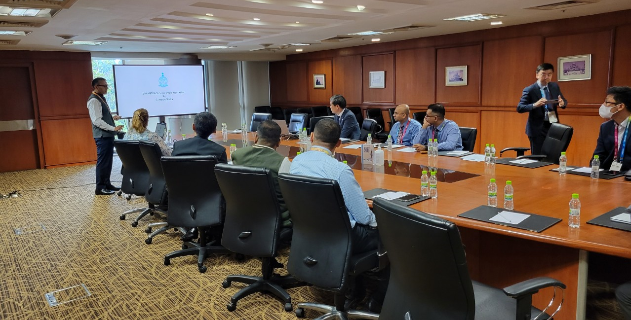
UN-GGIM-AP 11th Plenary Meeting Working Group 2
WG2 Parallel Meeting on Cadastre and Land Management, 12 October 2022
16 attendees inclusive of the World Bank representative

Slide 3
UN-GGIM-AP 11th Plenary Meeting Working Group 2
What we covered in our meeting are:
Key land related activities of WG2 up until 2022,
Digital India Land Records Modernization Programme in India,
Integrated Geospatial Information Management in Mongolia, Cambodia, the Philippines and Vietnam, by the World Bank,
Diagnostic results informed by the IGIF, by Korea,
Digital Twin and Urban Issues, by Korea,
SVAMITVA Scheme Implementation, by India,
Digital Underground: Towards developing a reliable map of subsurface utilities in Singapore for planning and land administration, by Singapore and
Development of resolution.

Slide 4
UN-GGIM-AP 11th Plenary Meeting Working Group 2
Objectives
Reaffirm the importance and pertinence of land and its administration and management at the global level for the implementation of the Sustainable Development Goals;
Support practical implementation of the Framework for Effective Land Administration as a reference for Member States when developing, reforming, strengthening and modernizing effective and efficient land administration processes and systems;
Recognize leveraging synergies, avoid duplication through collaboration with other working groups of UN-GGIM-AP;
Recognize the need to identify common grounds and challenges in land administration and management systems among the regional countries;

Slide 5
UN-GGIM-AP 11th Plenary Meeting Working Group 2
Challenges
Trends to migrate to fully digital platforms where every Member State is at different levels of development regarding their land administration and the need of people without digital or mobile access to land information;
Duplication through collaboration with other working groups of UN-GGIM-AP;
Special attention towards cybersecurity and data security needs to be given when improving the management of land and survey records and information while promoting transparency, accountability, and integrity, and including consideration for data privacy and protection.

Slide 6
UN-GGIM-AP 11th Plenary Meeting Working Group 2
Opportunities
Global and regional guidelines and frameworks such as the Integrated Geospatial Information Framework (IGIF) and the Framework for Effective Land Administration (FELA)
The IGIF reviewed in Mongolia, Cambodia, the Philippines, and Vietnam and more.
Singapore appointed as co-Chair of the Expert Group on Land Administration and Management of UN-GGIM
Emphasized the need to embrace technology to improve the user experience and data usage where the advancement of geospatial technology becomes more practical and accessible.

Slide 7
UN-GGIM-AP 11th Plenary Meeting Working Group 2
Work Plan
Utilize the Implementation Guide of IGIF as a reference resource when developing guidance to implement FELA at the country level
Translate the FELA into languages other than English as an important step in continuing advocacy, raising awareness, and promoting the merits and benefits of effective land administration
 | Activities | Notes
1 | Identify and monitor/share the most recent version of FELA document | The Chair is responsible
2 | Translate into other languages
3 | Encourage member countries to share their experiences, best practices, and lessons learned at the Plenary Meeting, Indonesia | November, 2023

Slide 8
UN-GGIM-AP 11th Plenary Meeting Working Group 2
Work Plan
Bridge geospatial divide among regional countries via identifying the field of areas and sharing best practices/capacity building dialogue and coordination via diverse forms of forum
In 2023, Korea invites officials from Indonesia, Lao PDR, Vietnam and Kyrgyzstan to Korea for short-term capacity building program
More opportunities can be bridged by ASEAN-ROK Cooperation Fund (AKCF), which requires agreement of the ASEAN member countries
 | Activities | Notes
1 | Identify common challenges and needs | The Chair is responsible
2 | Develop training and capacity opportunities and share these via UN GGIM AP networks
3 | Encourage member countries to share their experiences, best practices, and lessons learned at the Plenary Meeting, Indonesia | November, 2023

Slide 9
UN-GGIM-AP 11th Plenary Meeting Working Group 2
Resolutions
a) Continues to advocate and raise political awareness of the benefits of effective and efficient land administration and management as stipulated in decision 7/108;
b) Encourages Member States engaging in the Framework for Effective Land Administration, especially translating it in their own languages and practically implementing it, as leveraging the IGIF Implementation Guide, working with UN-GGIM Expert Group on Land Administration and Management;
c) Identifies and shares diverse forms of forum for dialogue and coordination to strengthen human capacity building related to cadaster and land management at the regional level that incorporates professionals, future young professionals, and vulnerable groups that also reflect gender equality by assessing current challenges faced by Member States and developing capacity building programs;
d) Requests the Secretariat to continue to explore possible options (in a cost neutral manner) for building a UN-GGIM-AP geospatial information service centre with all interested Member States for practical provision of geospatial services and products to member countries of UN-GGIM-AP, considering cooperation with the United Nations GIS Service Centre of the United Nations Office on ICT (UN OICT) in Brindisi, Italy.

Slide 10
Thank you very much
Working Group 2
Cadastre and Land Management

