Slide 1
12th UNGGIM-AP Plenary Meeting Bali - 2023
Geospatial Information Agency Indonesia

Slide 2
Bali, 6-9 November 2023
Host Country:
Geospatial Information Agency (BIG) - Indonesia
Agenda:
12th Plenary Meeting UNGGIM-AP November 6th ,2023
Indonesia Geospatial Forum and Workshop, November 7-8, 2023
Technical Visit – Bali November 9th, 2023

Slide 3
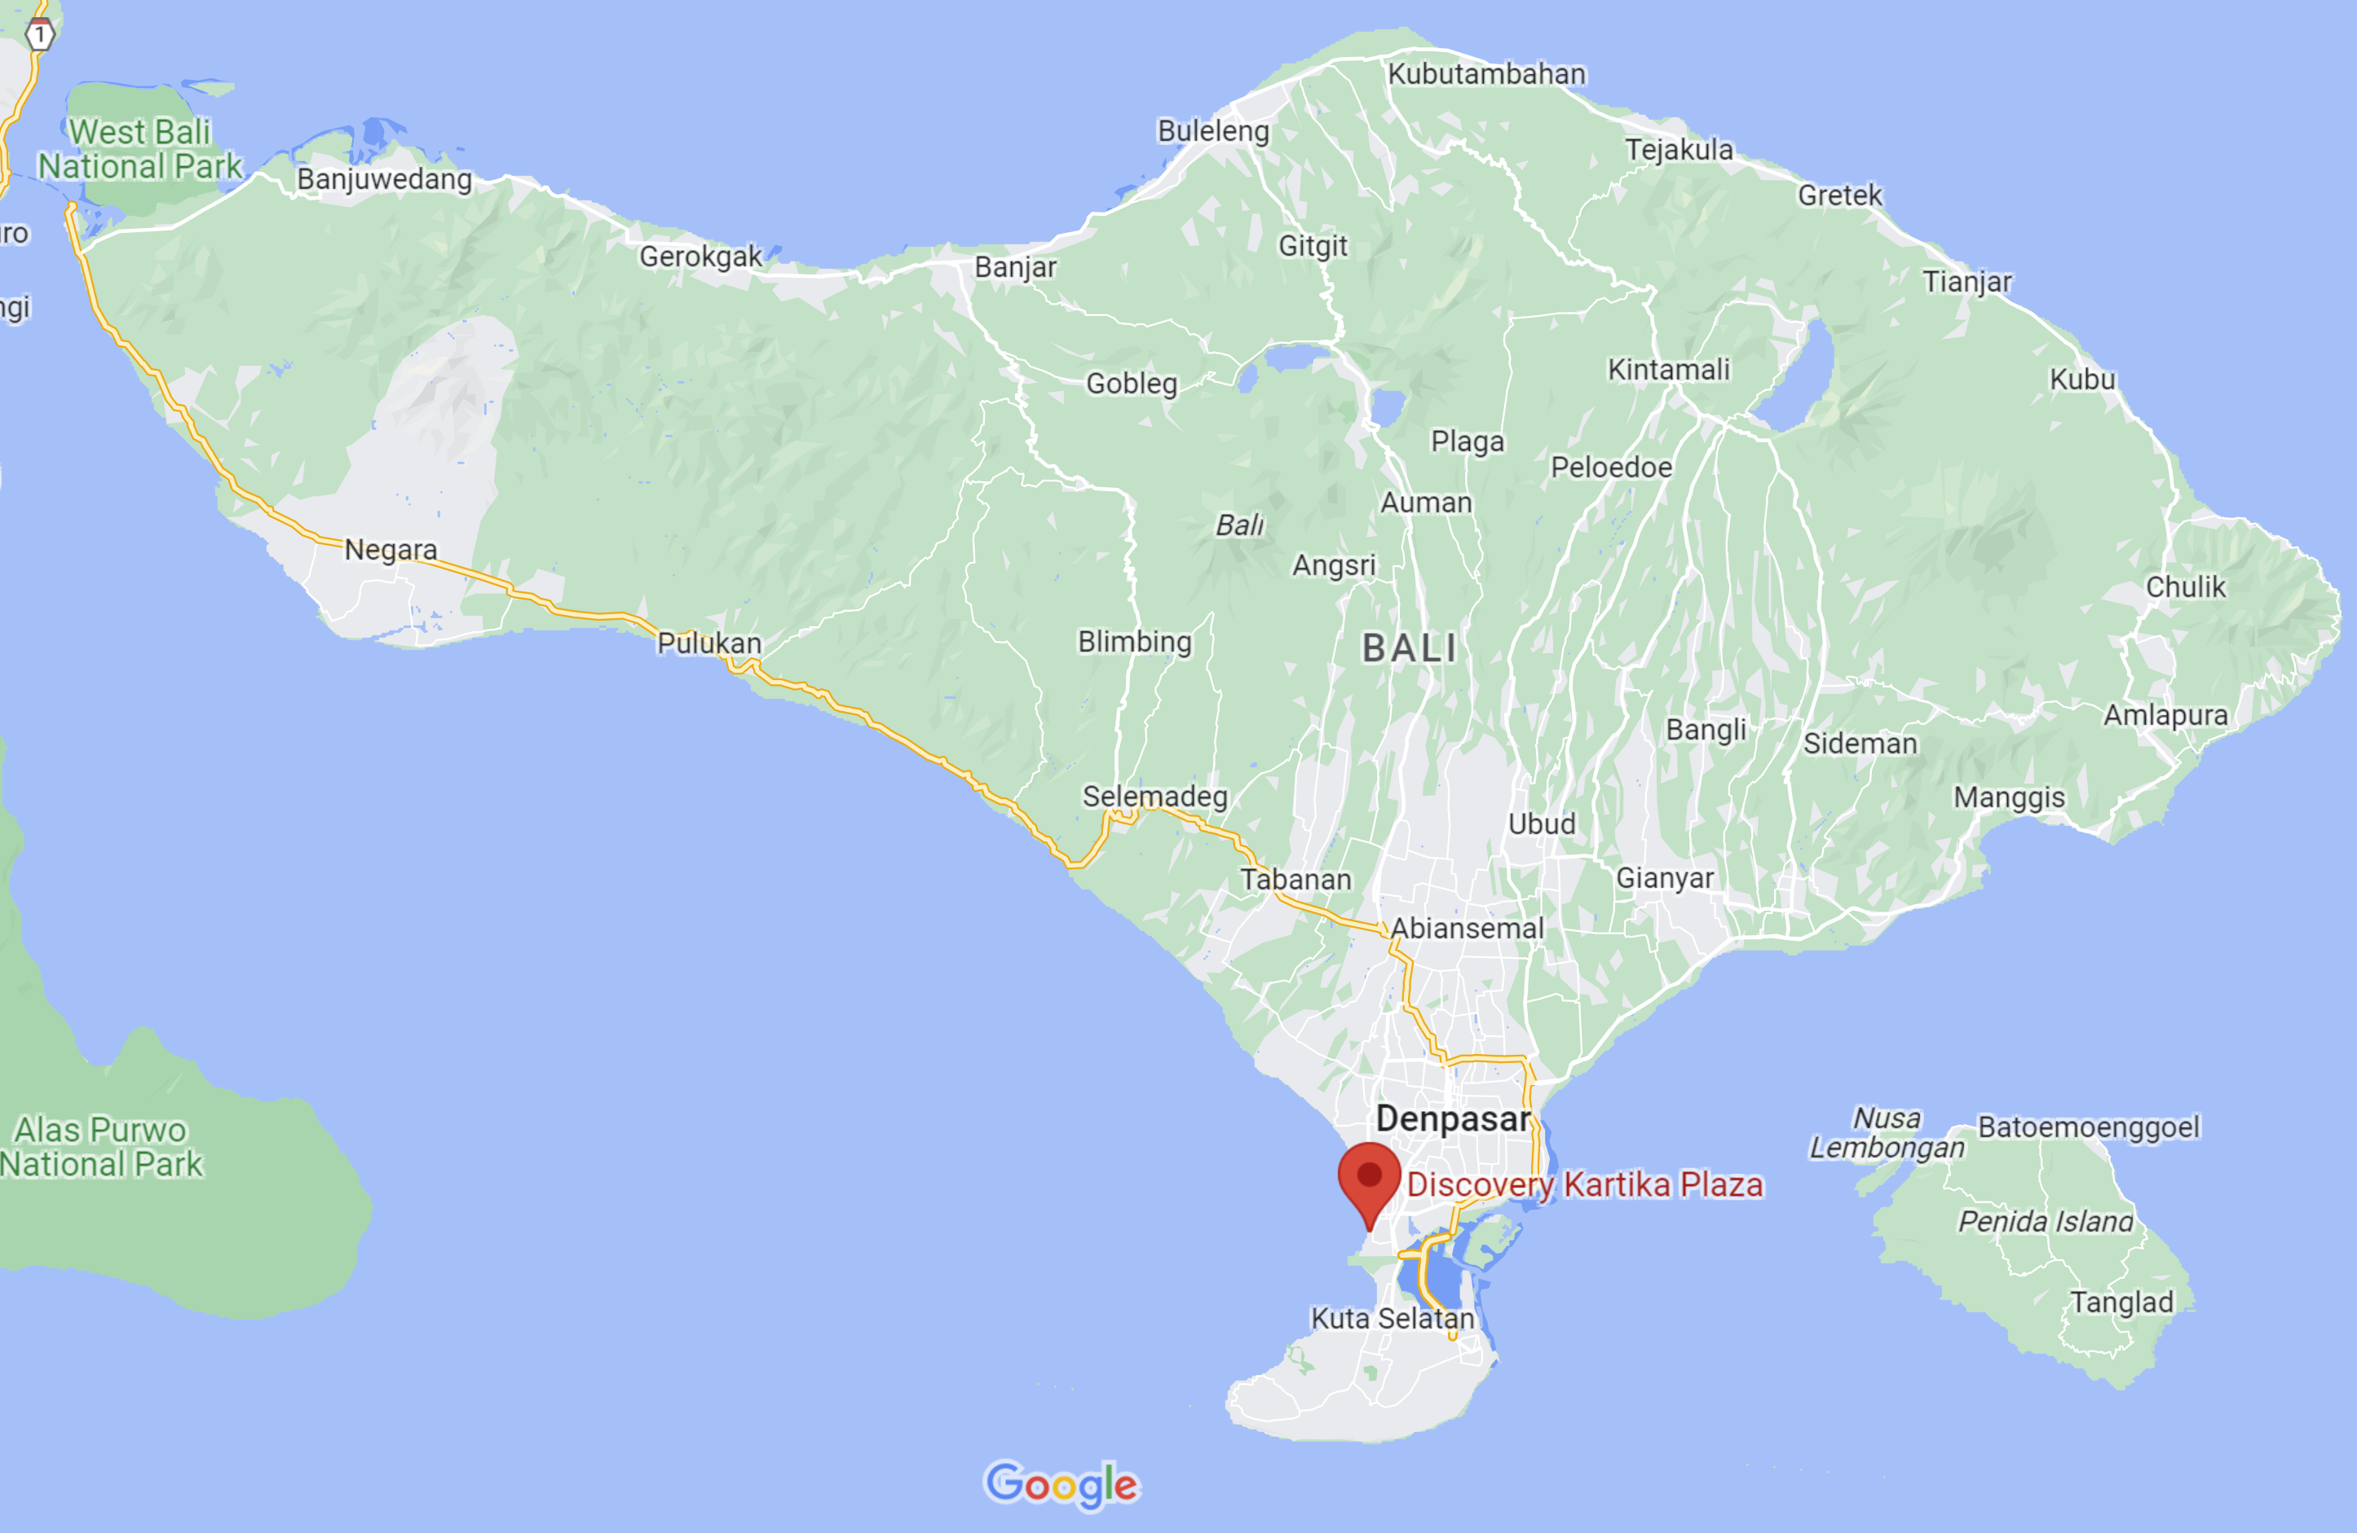
Detail Information
Venue: Discovery Kartika Plaza Hotel, Kuta - Bali (tentative)

Slide 4
Detail Information
Web-Information will be launch at April 2023
Indonesian Geospatial Forum “Embracing Geospatial Innovation for Sustainable World”,
Inviting Guest Speaker from EB Member
Opening Speaker in Parallel Session will be open in April-June 2023
Exhibiting geospatial business & innovation companies
Targeting audience from governments, industry, academia & community
Open Partnership

Slide 5
THANK YOU
Dheny Sampurno
dheny.trie@big.go.id

