Slide 1

UN-GGIM Private Sector Network
By
Prof Dr Eng Zaffar Sadiq Mohamed-Ghouse
HonFSSSI FRGS FIEAust
      Chair, Board of UN-GGIM Private Sector Network
      Chair, Asia-Pacific UN-GGIM Private Sector Network
      Board Member, UN-GGIM Geospatial Societies
UN-GGIM Aisa Pacific Executive Board Meeting
Singapore, 13/March/2022

Slide 2
UN-GGIM PSN: Purpose
This Private Sector Network (PSN) is intended to facilitate direct connections and communication
between the private sector and Member States in order for the private sector to collaborate with the Member States on global geospatial initiatives.
The PSN shall facilitate ongoing collaboration between and among UN-GGIM members and PSN participants to develop, build, and extend the world's capacity to benefit from geospatial information, thereby enabling countries to develop capacity in geospatial information, technologies, and services.
Recognising the private sector's expertise, the PSN will create opportunities for this expertise to assist the UN-GGIM in developing national, regional, and global policies, processes, practices, capacities, and recommendations for geospatial information infrastructure.

Slide 3
PSN Board Vision
An active Private Sector Network (PSN) of representatives working in a mutually beneficial collaboration with the members of UN-GGIM to play a leading role in setting the agenda for the development of global geospatial information and to promote its use to address key global challenges, enable citizen services and support the initiatives of the United Nations, particularly the global development agenda.

Slide 4
UNGGIM-PSN is voluntary self-organised group and shall have its own process and policies. Though UNGGIM Secretariat doesn't influence or interfere in day-to-day functioning, it's expected that PSN process and programs are compliant and aligned with UNGGIM goals and guidelines. Based on experiences and feedback PSN Secretariat provides the following for consideration by members and officials of PSN:
PSN members and officials should provide and commit sufficient time to lead and organize the activities of PSN.
PSN members and officials should inbuild the cost of travel on their own to important UNGGIM Bureau meetings and regional meetings, respectively.
PSN members and officials shall be conscious of any potential conflict of interest while representing PSN and engaging with member states.

Slide 5
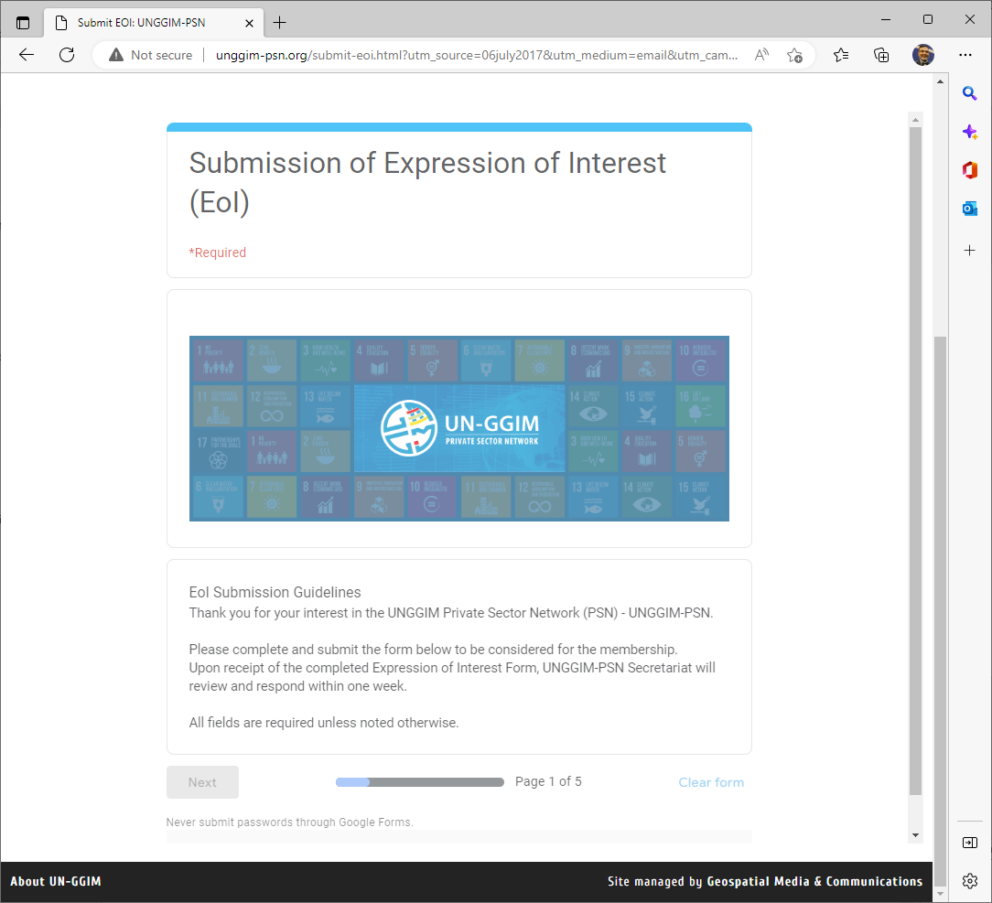
Joining UNGGIM PSN
http://unggim-psn.org

Slide 6
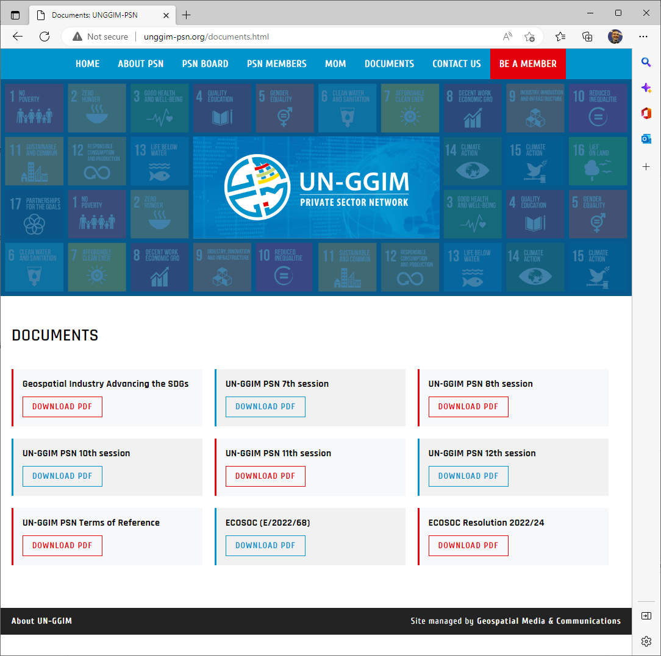

Slide 7


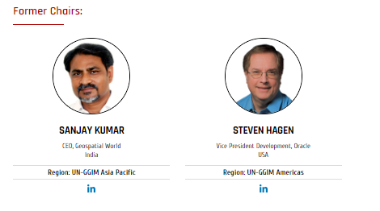
2023-2025
LEADERSHIP
OF
UN-GGIM PSN

Slide 8

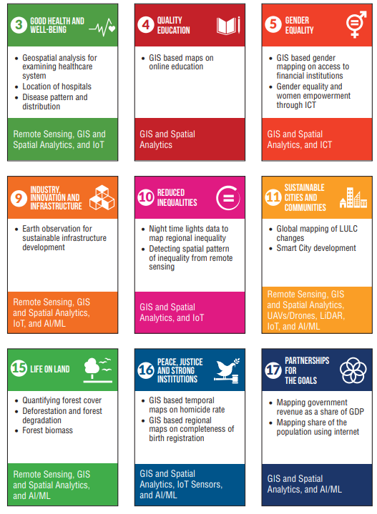
https://ggim.un.org/meetings/GGIM-committee/11th-Session/documents/Geospatial_Industry_Advancing_the_SDGs.pdf

Slide 9
UNGGIM PSN AMERICAS Strategic Goals:
Participate in All UNGGIM Americas Working Groups in order to achieve
Private Sector perspective captured in outcome documents and Private Sector Adoption of Standards.
Partner with UNGGIM Americas Academic Network to achieve greater engagement between Academia and Industry.
Continue to participate actively in CARIGEO which includes:
  • Participation in Weekly Meetings
  • Private Sector Contribution to Standards
  • Presentation in Webinars
  • Proposal Writing
  • Special Projects
Participate in UNGGIM-A/AmeriGEO Joint initiatives towards, Joint Action plan 2021-2024
Work with the UN-GGIM Global Private Sector Network with a focus on reorganized Functional Global Committee and advanced global priorities.

Slide 10


Slide 11
UNGGIM PSN Asia Pacific Strategic Goal:
Actively take part and contribute in respective working groups in Asia Pacific
Co-organize Webinars with secretariat
Co-organize UN-Network Activities in Asia Pacific
Promote IGIF Framework and SDGs in Private Sector Network
Advocate Economic Benefits Study on Value of Spatial Information in Asia-Pacific
Closely collaborate with Space – Spatial Industry sector

Slide 12
UNGGIM PSN Arab-States Strategic Goals:
Actively take part and contribute to respective working groups in the UN-GGIM Arab States
Promote coordination with the Arab State Private Sector Network and UN-GGIM-PSN
Facilitate workshops in partnership with the UN-GGIM Arab State secretariat
Promote IGIF Framework and SDGs in Private Sector Network
Build a partnership with UN-GGIM Academic Network & enhance cooperation within networks

Slide 13
PSN expert group Land Administration and Management
  Letter Structure and Operation of the New Global Geodetic Centre of Excellence in Bonn also offering PSN support
  Letter to UN-GGIM Sub-Committee Geodesy Seeking Cooperation with PSN, PSN Board Members to seek the cooperation of the PSN with further UN-GGIM Expert Groups.

Slide 14
PSN Expert group: Integration of Statistical and Geospatial Information
▪ This expert group the process of identifying priorities with the United Nations Expert Group on the Integration of Statistical and Geospatial Information and planning future engagement and activities accordingly.
▪ Concentrate on IGIF implementation. There are currently ongoing projects that demonstrate how the IGIF is being used and deployed in terms of government capacity building and technology deployment within specific projects and with the support of the private sector. Thus, focusing on
eliciting explicit support from the private sector.
▪ Another area is the Global Statistical Geospatial Framework (GSGF), where the PSN intends to focus on.
PSN Thematic Group: Legal and Policy Frameworks
o The legal and Policy Committee of UN-GGIM held an open workshop with the
member Nations and there was a heavy discussion on three basic documents or
templates.
O PSN is considering a review of these documents, even though they’re largely scope
For the government, there is still a really good opportunity for the private sector to weigh
in on these documents.

Slide 15
Core Expert Group
o A core group within the PSN Board was formed with a focus on highlighting the private sector perspective of new areas of applications and novel technologies.
It shall aim at highlighting how geospatial technology can be integrated into society
and economy through some white papers/technology direction papers etc.

Slide 16
Core Expert Group
o A core group within the PSN Board was formed with a focus on highlighting the private sector perspective of new areas of applications and novel technologies.
It shall aim at highlighting how geospatial technology can be integrated into society
and economy through some white papers/technology direction papers etc.

Slide 17
Thank You
Let’s develop a positive and enduring impact on a sustainable world using geospatial information, leaving no one behind
Prof Dr Eng Zaffar Sadiq Mohamed-Ghouse HonFSSSI FRGS FIEAust
Chair, UN-GGIM Board PSN
Chair, UN-GGIM Asia Pacific PSN
Board Member, UN-GGIM Geospatial Societies

